Slide 1
19CSE202 Data Base Management System
Topic: Township Management System
Team Members:
BL.EN. U4CSE20053 GUNTURI AKSHITA
BL.EN. U4CSE20093 MALLA CHANDU
BL.EN. U4CSE20139 RATNAKARAM SASANK
BL.EN. U4CSE20153 SANDAYYAGARI AKSHAY REDDY

Slide 2
Agenda
Abstract
ER Diagram
Table Conversion
Presentation(Module Explanation)
Demo

Slide 3
Brief Description of the Project:
Why have we chosen this township management system?
To gain practical knowledge about drawing ER Diagrams, creating tables and working of application
Increasing demand for gated communities in metropolitan cities
Many gated communities do not have formal database system
Working process of our system
Designed to cater to the effective management of a gated community.
Users of this application
The users of our project are admins of the gated community, owners and tenants of villas.

Slide 4
Functions of the Application
The functions of our township management system are:
Maintenance: owners can pay their maintenance charges (monthly or annually); owners can raise issues regarding plumbing and electrical issues.
Security system: video phone entry, access control doors, access to CCTV footage if required.
Amenities: owners can book party halls, they can also use other indoor facilities like reading room, health club, gymnasium, sports area.
Member details: management can change (add or delete or manage) the member details if required.

Slide 5
Technologies used for the Application
Front End: HTML, CSS
Server Side: Servlets, Tomcat
Database: Oracle SQL for creating database

Slide 6
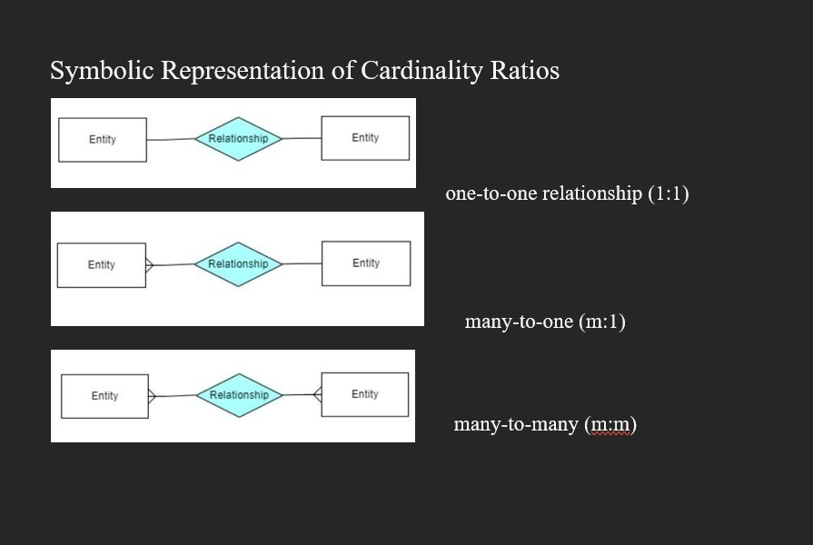

Slide 7
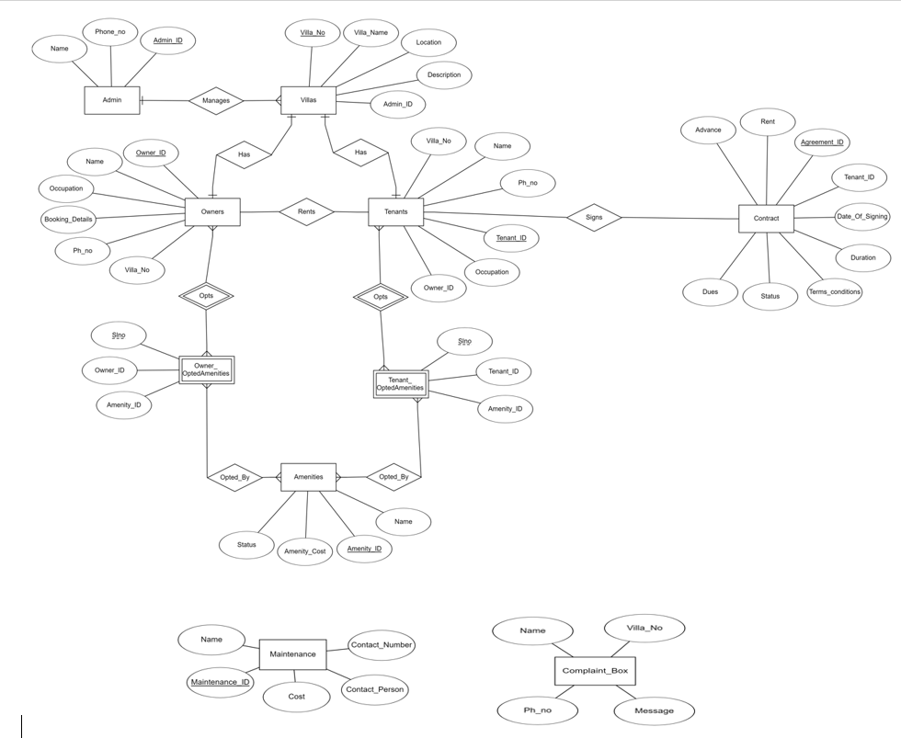
ER Diagram

Slide 8
Mapping ER Diagram to Relational Model
Terms: Relation, tuples, attributes
Null values are eliminated
Tuple can be uniquely identified by Keys- primary key
Primary key uniquely identifies a table; PK is listed before all other attributes in a relational table
Minimum no. of tables obtained after mapping are:
m:n relationship – 3 tables
m:1 or 1:m relationship – 2 tables
1:1 relationship – 2 tables

Slide 9
Table Structures in SQL
Tables are created using CREATE, values are inserted using INSERT commands
Business rules/ constraints: PRIMARY KEY, FOREIGN KEY, UNIQUE, NOTNULL, etc.
desc <tablename>
SELECT * FROM <tablename>

Slide 10
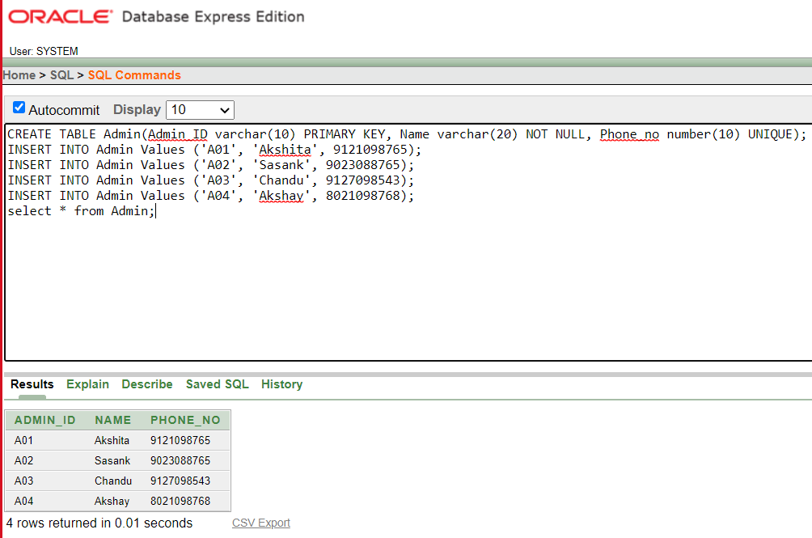

Slide 11
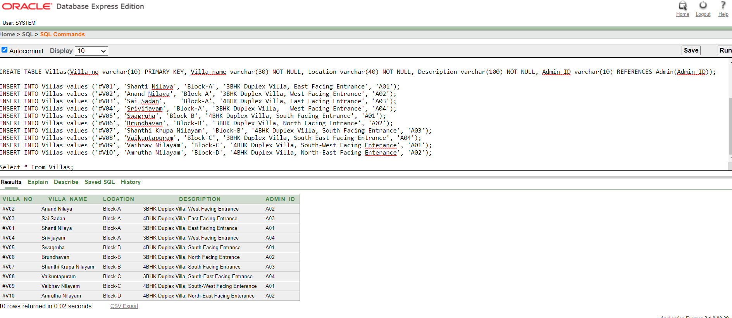

Slide 12
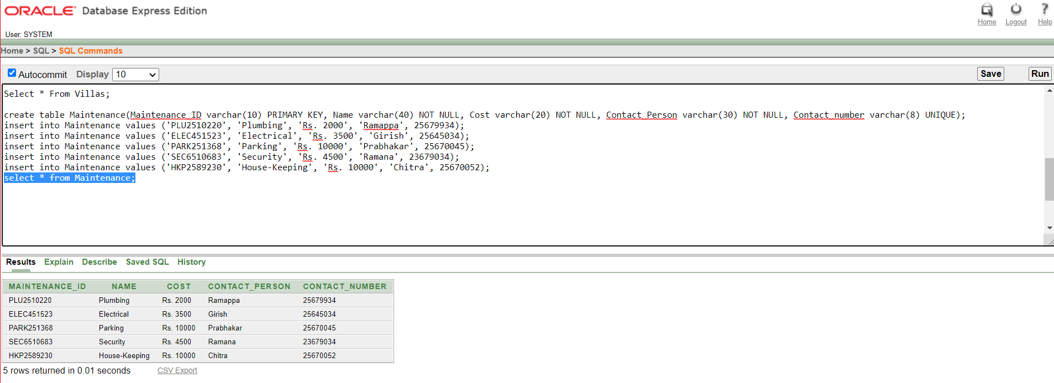

Slide 13
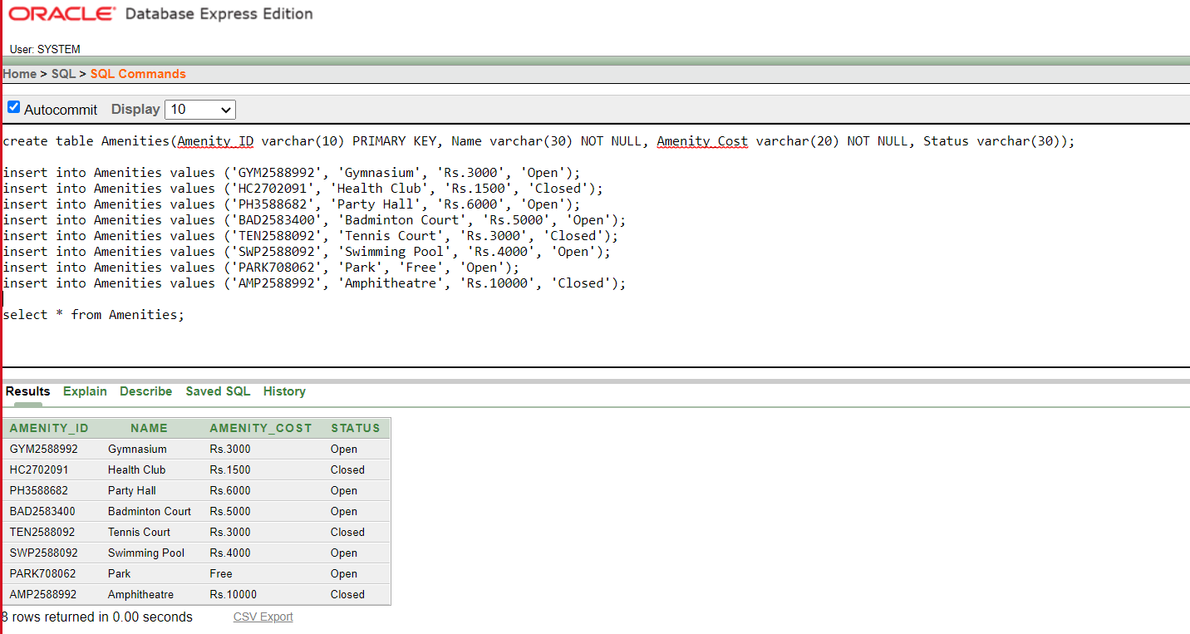

Slide 14
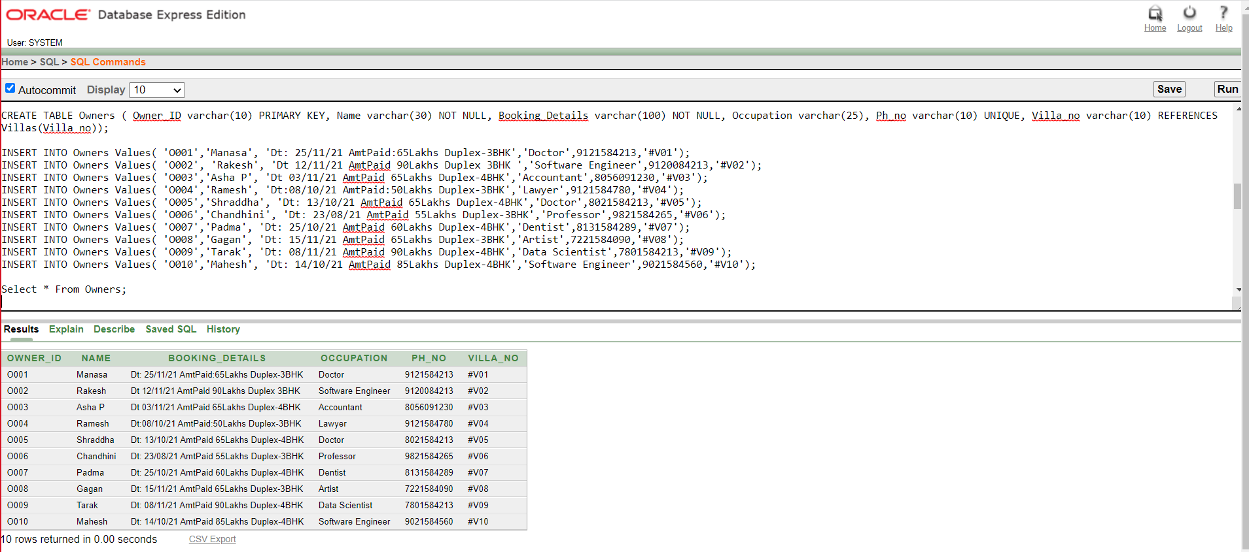

Slide 15
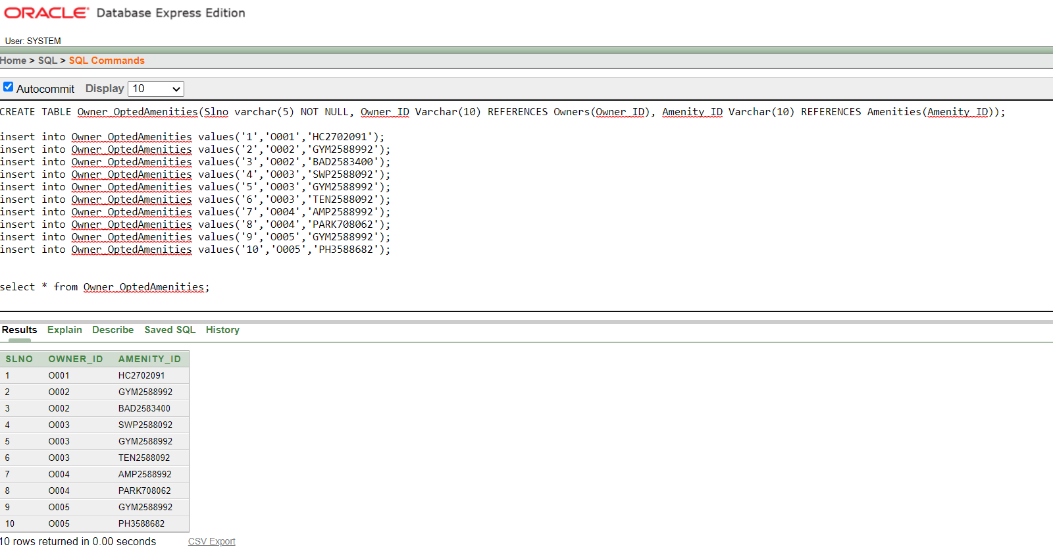

Slide 16
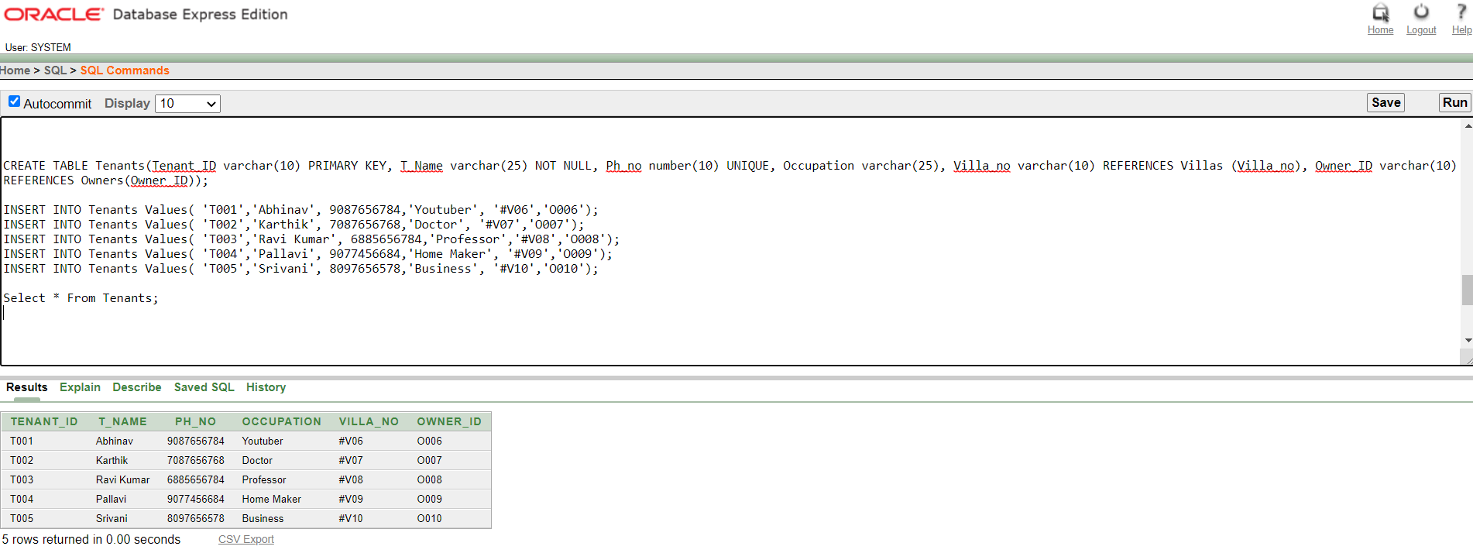

Slide 17
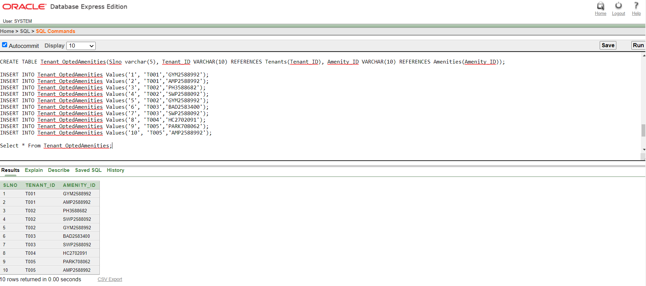

Slide 18
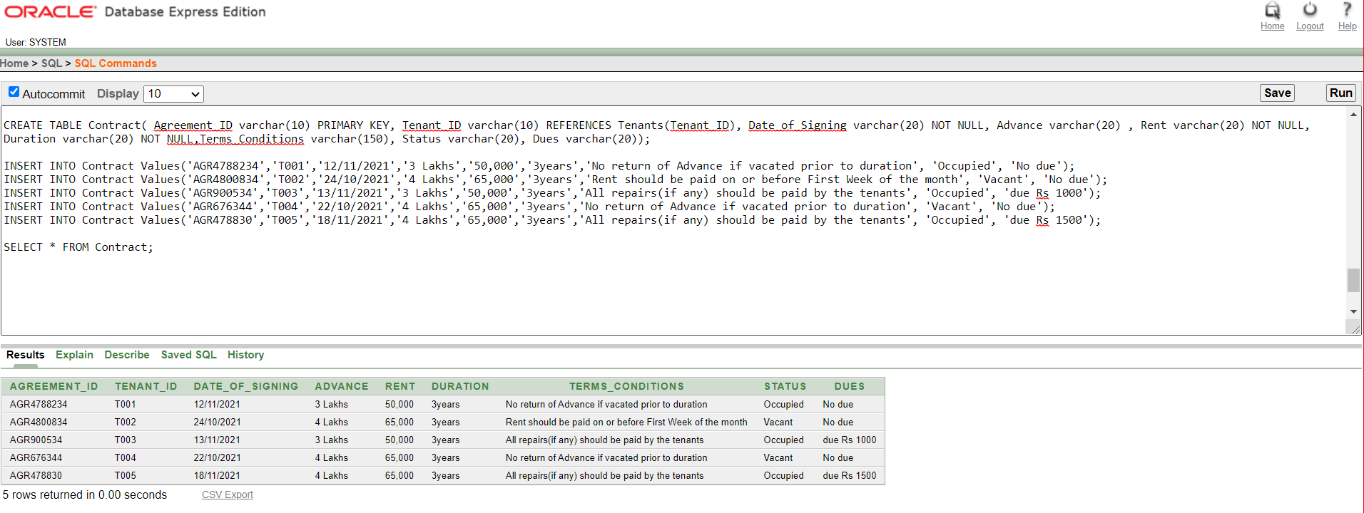

Slide 19

Screenshots of the application

Slide 20
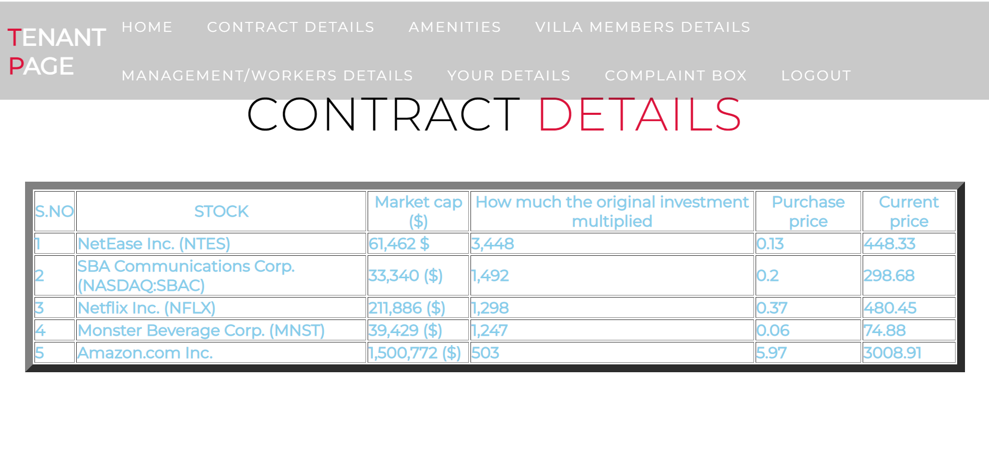

Slide 21

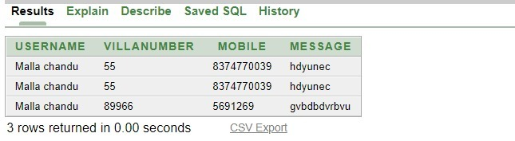

Slide 22
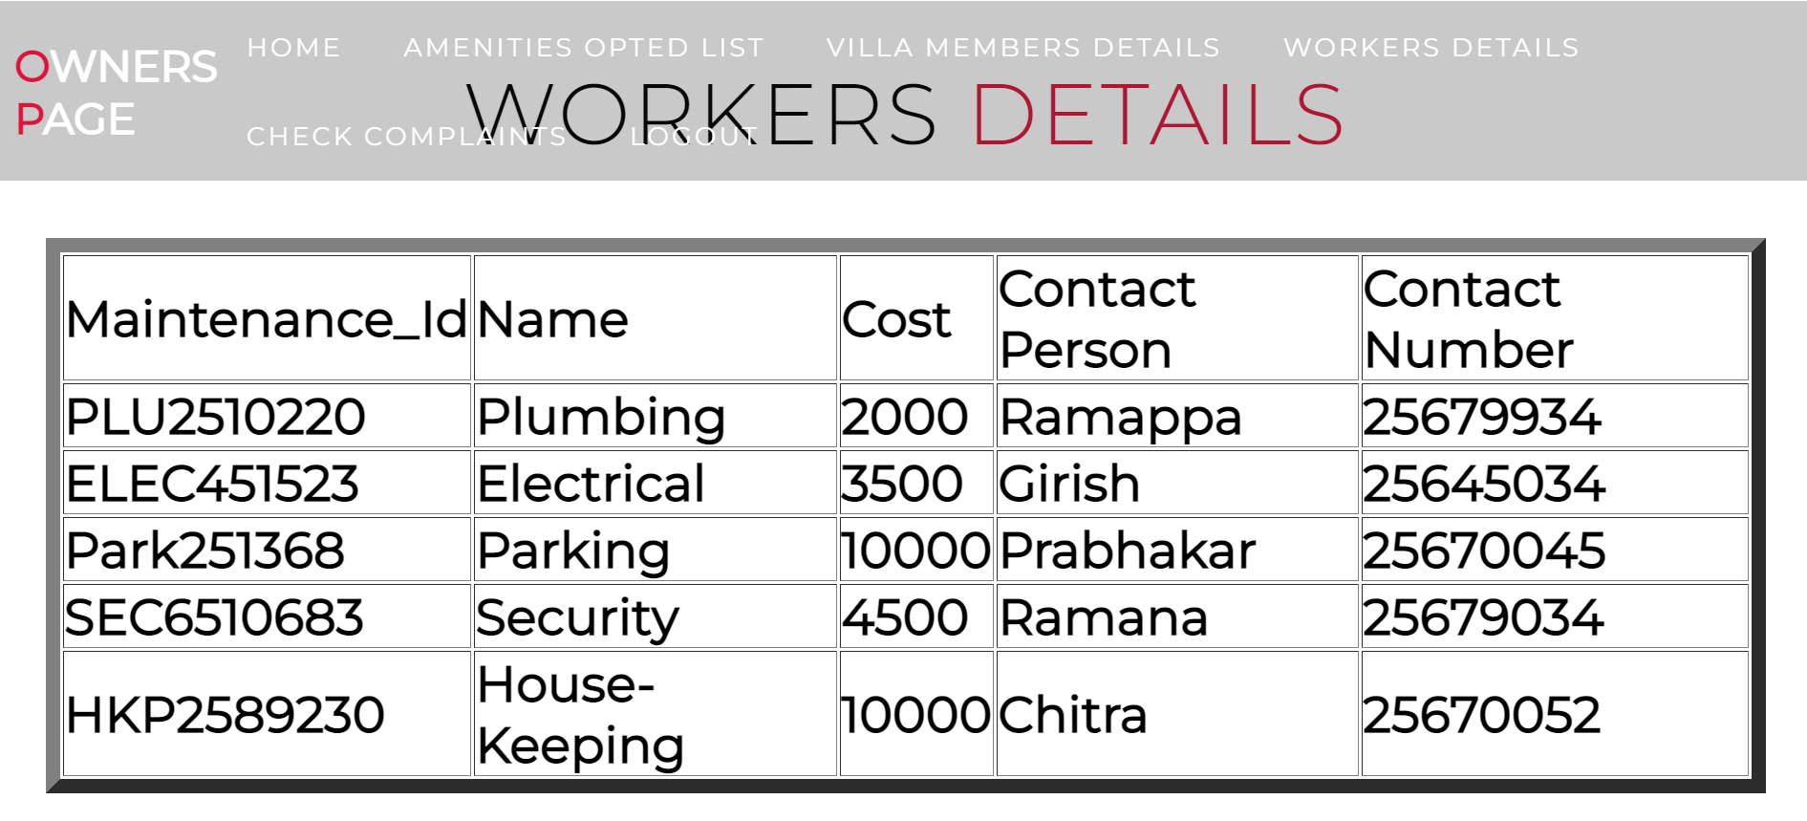

Slide 23
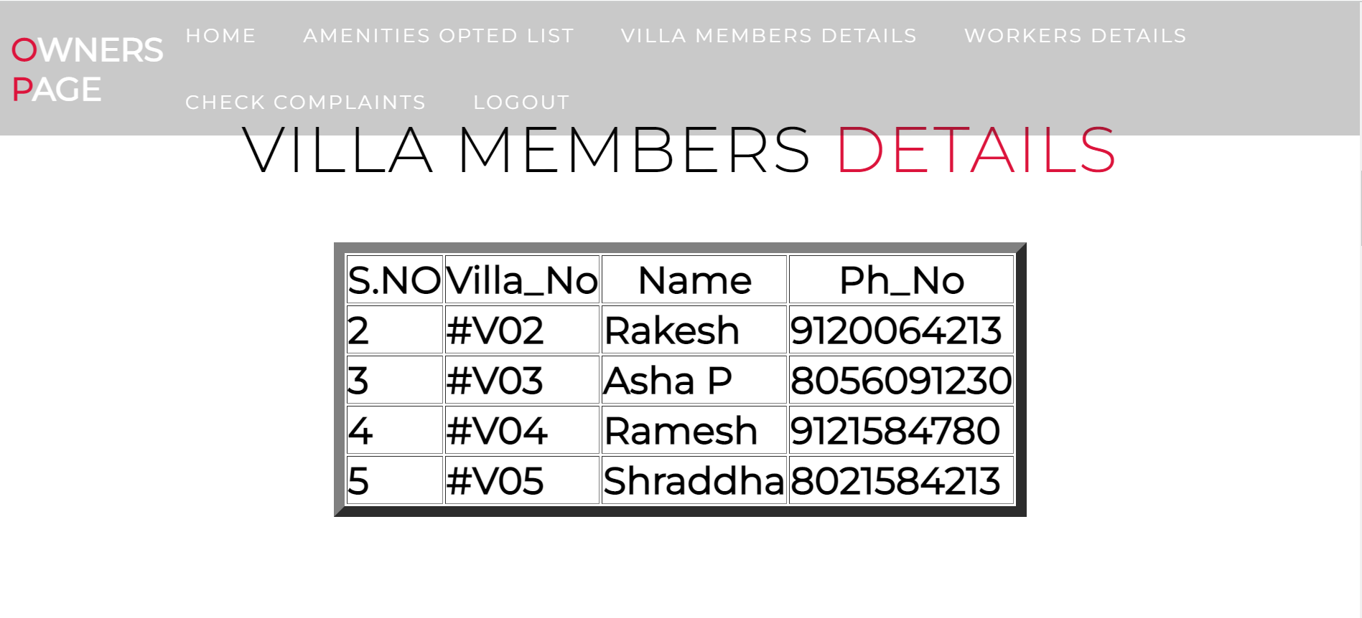

Slide 24

